Slide 1

Predicting Premier League Match Outcomes using Machine Learning.
Srihari Mohan - 23069726 - Github
M.Sc Data Science
Supervisor - Ralf Napiwotzki

Slide 2
Research Question & Objectives
Research Question: To what extent can Machine Learning predict match outcomes of English Premier League matches using historical match statistics? And which performance metrics are the most significant predictors of success?.
Objectives:
Review of existing research in football analytics & match outcome prediction.
Collect, Clean & derive features from the dataset.
Develop, Train & Optimise the best of three models.
Evaluate & compare models predictive performance using metrics beyond simple accuracy
Interpret the best performing model to identify and analyse the key outcomes.

Slide 3
Dataset & Preprocessing
Dataset: “England CSV” (12,000+ matches). Kaggle source. Includes Goals, Shots, Fouls, Corners, etc data (1993-2025) of EPL.
Ethics: It follows all the university ethics and approved by the supervisor.
Preprocessing:
Dropped rows with missing stats
Excluded team names to prevent historical bias, included only required columns for the analysis.
Created different stats as features (e.g., ShotsonTargetDiff, RedDiff, etc.)
Converted Target variable Results(Home, Draw, Away) to numbers(0,1, 2).

Slide 4
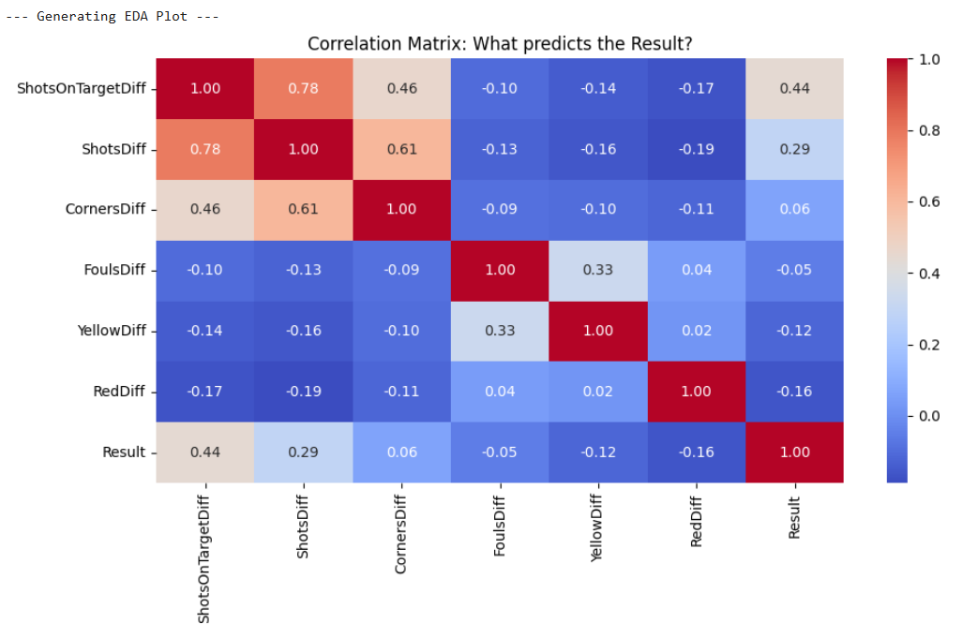
Exploratory Data Analysis
Exploratory Data Analysis to understand the data. In this correlation matrix, the feature 'Shots on Target Difference' has the strongest correlation with the result.
This scientifically justifies why it is the most important input for my model. Features like 'Fouls Difference' had very low correlation, suggesting they are less predictive."

Slide 5

Model Comparison
Models Tested: Logistic Regression, Random Forest and XGBoost.
Performance:
Key Takeaway: The simpler linear model outperformed complex tree-based models, suggesting linear relationships are dominant in this data.
Model Name | Score
Logistic Regression | ~56%
Random Forest | ~52%
XGBoost | ~55%

Slide 6

Optimisation
Process: Used GridSearchCV to tune the model.
Model Selected: Logistic Regression was selected as it outperformed complex tree-based models initially.
Parameters Tuned:
C (Regularization): To control overfitting vs. underfitting.
solver: Tested 'lbfgs' vs 'liblinear' for mathematical convergence.
Result: The grid search identified C=0.01 as the optimal setting, improving generalisation on unseen data.

Slide 7
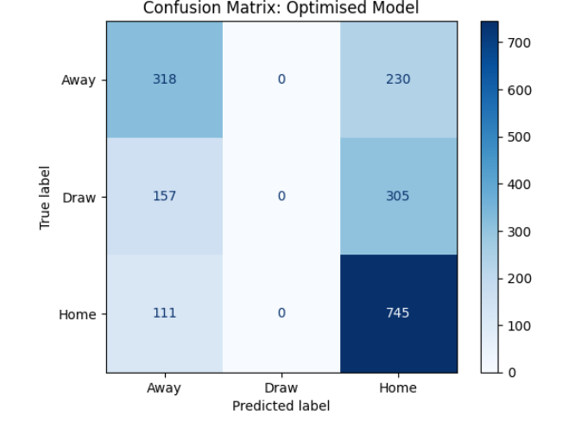
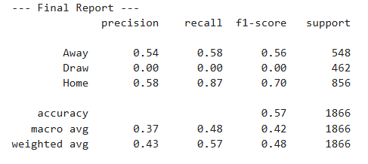
Results
Key Metrics:
Final Accuracy: 56% (vs. Random Chance of 33%).
Precision: High for Home Wins, Low for Draws.
Observation: The model effectively predicts wins/losses but struggles with Draws (the "Stochastic" element of football).

Slide 8
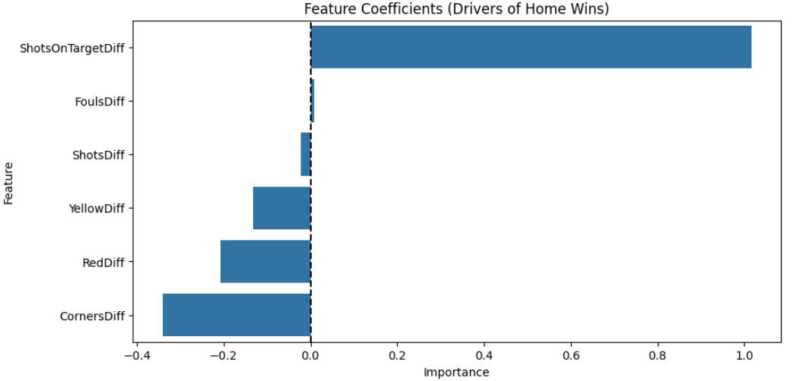
Analysis
Critical Analysis:
#1 Predictor: ShotsOnTargetDiff (Positive Coefficient) – Proves that offensive efficiency is the biggest driver of wins.
Negative Driver: RedCardDiff – Getting a red card significantly penalises chances.
Noise: FoulsDiff had low importance, suggesting aggressive play does not guarantee wins.

Slide 9
Conclusion
Simple linear models (Logistic Regression) outperformed complex ones (XGBoost) for this dataset. Match outcomes are ~56% predictable based on stats; the rest is luck/human factors.
Limitations: Current model uses post-match statistics.
Future Work:
Implement Rolling Averages (Team Form) to allow for pre-match forecasting.
Integrate Player-level data (injuries/lineups).

Slide 10
References
Reference 1 (The Classic Statistical Model):
Maher, M.J., (1982), ‘Modelling association football scores’, Statistica Neerlandica, 36(3), pp. 109-118. (Available at: https://doi.org/10.1111/j.1467-9574.1982.tb00782.x)
Reference 2 (Machine Learning specific - use this for XGBoost/Random Forest):
Baboota, R. and Kaur, H., (2019), ‘Predictive analysis and modelling football results using machine learning approach for English Premier League’, International Journal of Forecasting, 35(2), pp. 741-755. (Available at: https://doi.org/10.1016/j.ijforecast.2018.01.003)
Reference 3 (Comparing Models):
Shin, J. and Gasparyan, R., (2014), ‘A novel way to soccer match prediction’, International Journal of Contents, 10(4), pp. 46-51. (Available at: https://doi.org/10.5392/IJoC.2014.10.4.046)

